Slide 1
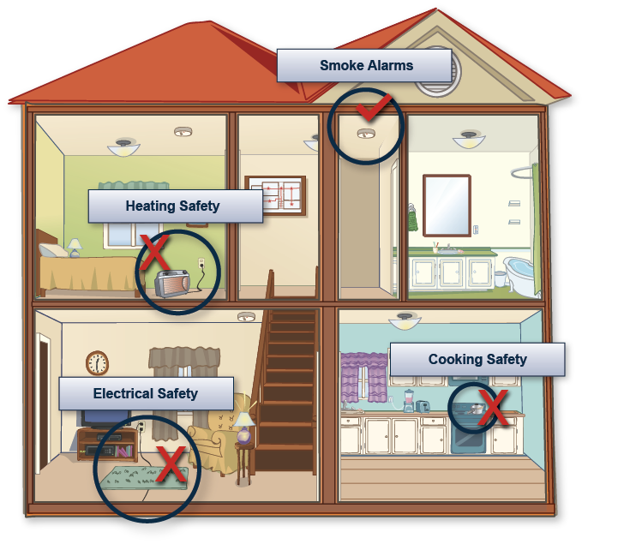
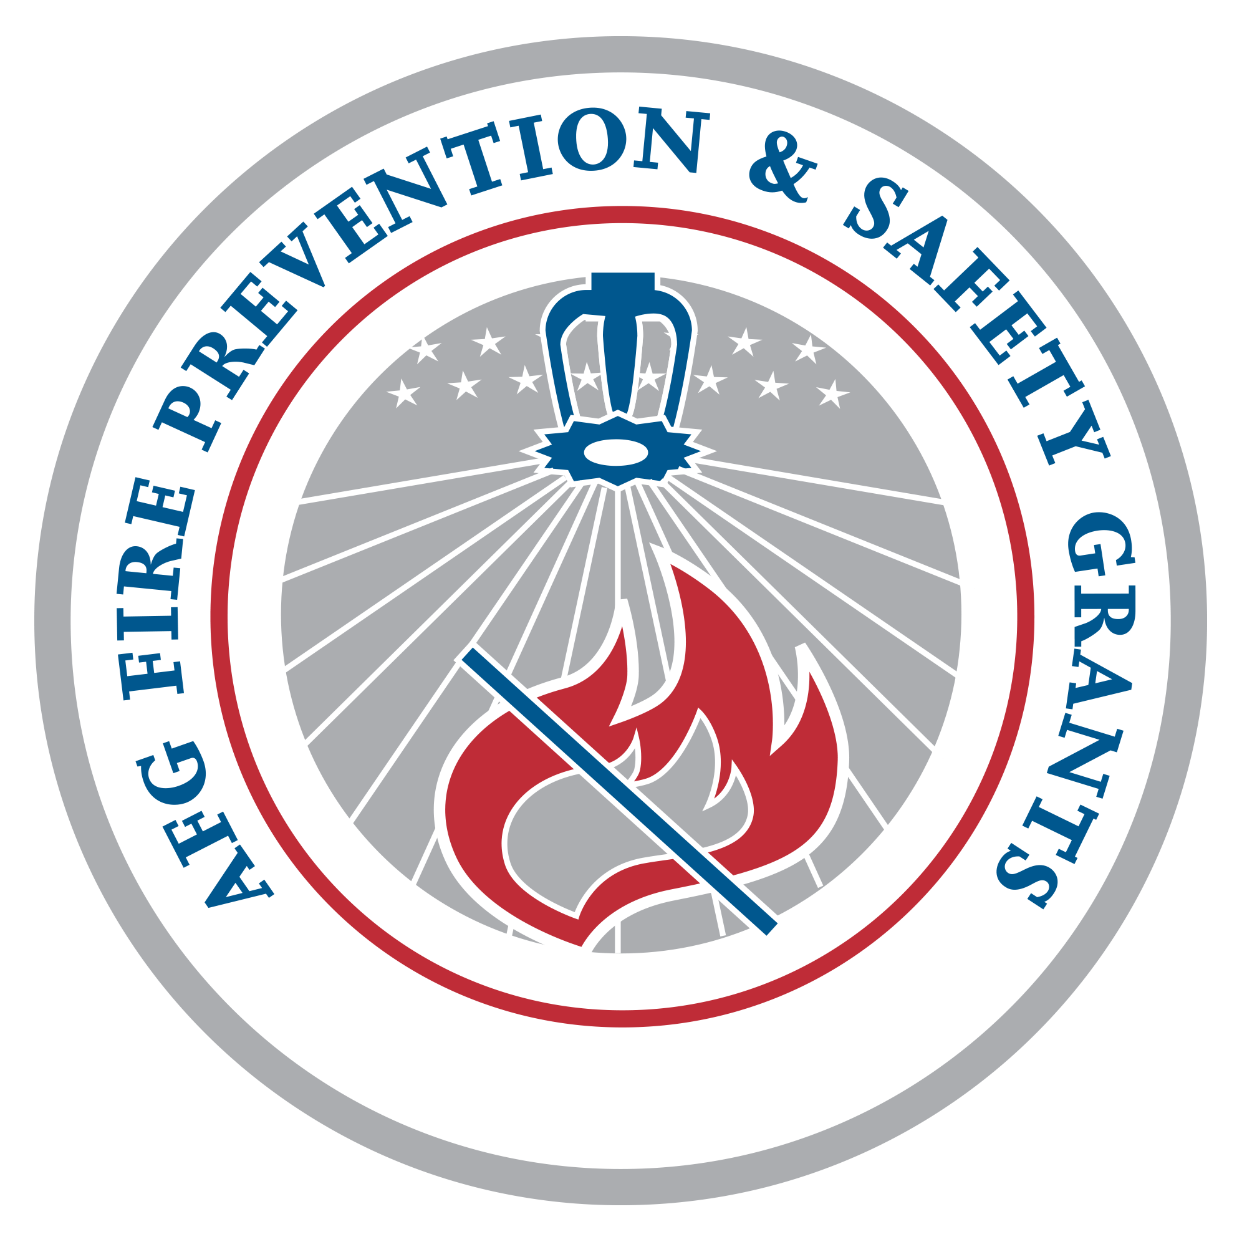
Home Fire Safety for Older Adults
A Community Education/Outreach Presentation
Notes:
The U.S. fire problem is severe. Each year, home fires result in a significant number of deaths and injuries. Older adults (ages 65+) are burdened with the gravest fire risk and are consistently more threatened with injury or death by fire than any other age group. Raising awareness among older adults is the key to reducing home fires and preventing deaths.
The Electrical Safety Foundation International (ESFI) was awarded a 2011 Fire Prevention and Safety (FP&S) Grant from the U.S. Department of Homeland Security’s Federal Emergency Management Agency to develop new fire safety awareness resources for older adults.
ESFI encourages you to use this presentation and the complementary Home Fire Safety for Older Adults awareness program resources (www.esfi.org/educators) to promote fire safety awareness among older adults in your community. The program provides tools to educate older adults and their families about home fire hazards related to cooking, heating, and electrical equipment. The critical importance of working smoke alarms in also reinforced.
Please use the notes provided for each of these slides to assist you with your awareness presentation. For additional information, please contact ESFI at info@esfi.org or (703) 841-3229.
Thank you for helping to increase fire safety awareness among this extremely vulnerable population.

Slide 2
Who is ESFI?
The premier non-profit organization dedicated exclusively to promoting electrical safety through education, awareness and advocacy.
Awarded a 2011 Fire Prevention and Safety (FP&S) Grant from DHS/FEMA to develop fire safety resources for specific at-risk populations, including older adults (ages 65+).
Notes:
The Electrical Safety Foundation International (ESFI) is the premier non-profit organization dedicated to promoting electrical safety at home, at school, and in the workplace. ESFI serves as a national authority for electrical safety information.
ESFI is committed to:
Being the unbiased authority on electrical safety issues for consumers, the workforce, and the media;
Identifying and addressing evolving electrical safety needs;
Developing cost-effective safety materials and programs that break down technical concepts into easy safety tips; and
Advocating safety technology, compliance with codes and standards, and risk-reducing behaviors.
ESFI proudly sponsors National Electrical Safety Month each May and engages in public education campaigns through the year to increase electrical safety awareness in order to reduce electrically-related fatalities, injuries, and property loss.

Slide 3
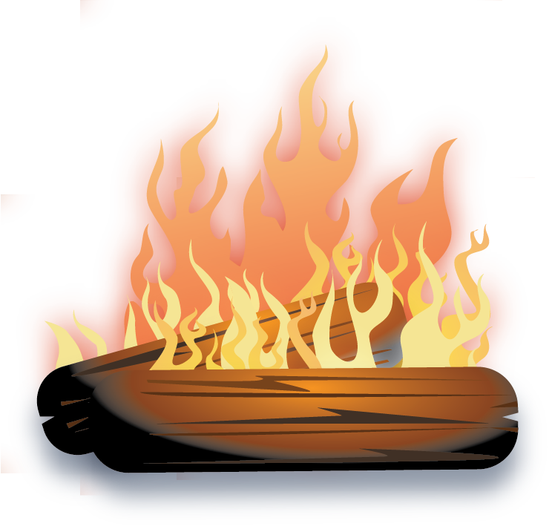
Why is Fire Safety Important?
Fires happen every day and the toll they take on our lives is boundless
Every 24 seconds a fire department responds to a fire
Every 65 seconds, a fire occurs in a structure, and a residential fire strikes every 85 seconds
A fire claims a civilian life every 2 hours and 49 minutes and results in a civilian injury every 30 minutes
62% of home fire deaths occur in homes with either no smoke alarms or no working smoke alarms.
Notes:
These statistics have been provided by the National Fire Protection Association (NFPA).
For additional information, visit their website at:
http://www.nfpa.org/categoryList.asp?categoryID=953&URL=Research/Fire%20statistics/The%20U.S.%20fire%20problem

Slide 4
Leading Causes of Home Fires
Cooking:
U.S. fire departments respond to an average of 155,400 cooking fires per year.
Unattended cooking is the leading cause of cooking fires
Heating Equipment:
In 2010, heating equipment was the second leading cause of home fires and home fire deaths.
Space heaters result in far more fires and losses than central heating devices.
Electrical Equipment and Distribution System:
In 2005-2009, electrical fires represented 13% of all home fires and 17% of associated fire deaths.
In 2009 alone, 44,800 home fires involved some type of electrical failure or malfunction. These fires resulted in 472 deaths and 1,500 injuries.
Notes:
Understanding the common causes of home fires is the critical first step in preventing them. Year after year, cooking, heating and electrical equipment continue to be among the leading causes of home fires.
This presentation outlines fire prevention strategies related to each of these major causes, as well as key fire preparation strategies.
The statistics provided on slides 4 and 5 have been compiled from reports issued by the National Fire Protection Association (NFPA) and the U.S. Fire administration (USFA), including:
Home Structure Fires, National Fire Protection Association, August 2012
http://www.nfpa.org/assets/files/pdf/os.homes.pdf
Home Electrical Fires, National Fire Protection Association, January 2012
http://www.nfpa.org/assets/files/pdf/os.electrical.pdf
Home Fires Involving Cooking Equipment, National Fire Protection Association, November 2011
http://www.nfpa.org/assets/files/pdf/os.cooking.pdf
Characteristics of Home Fire Victims, National Fire Protection Association, March 2010
http://www.nfpa.org/assets/files/pdf/os.homevictims.pdf
A comprehensive list of statistical resources is provided in the ESFI Home Fire Safety for Older Adults Safety Awareness Program Toolkit (www.esfi.org/educators).

Slide 5
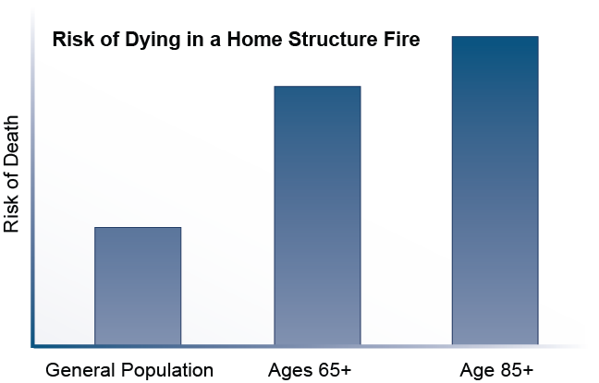
How Does Fire Affect Older Adults?
Adults over 65 have the highest risk of death from fire
The risk of fire death for those 65+ is 2 times higher than the general population
Risk increases with age – adults age 85+ have a risk that is 3.7 times higher
The risk of dying from cooking or heating fires is twice that of the general population for those 75+
People 75+ also have a higher risk of dying from electrical fires

Slide 6
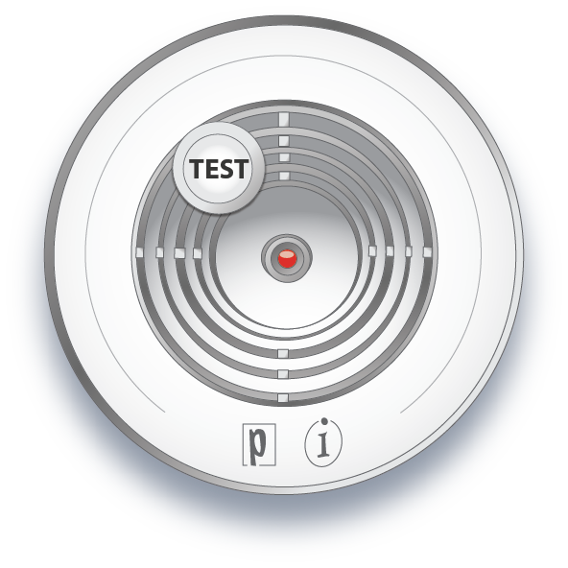
Reducing the Risks for Older Adults
Fire Prevention Strategies:
Follow good fire safety practices
Identify and correct home fire hazards
Fire Preparation Strategies:
Develop a fire escape plan and practice it
Install and properly maintain smoke alarms
Notes:
There are two different types of fire safety strategies – prevention strategies and preparation strategies. The best way to keep older adults safe from home fires is to ensure they are taking steps to prevent fires while at the same time making preparations to safely escape if there is a fire emergency.
This presentation focuses on fire prevention strategies related to cooking, heating, and electrical equipment.
Basic fire safety preparation information is also provided to help older adults ensure they are protected by working, properly installed smoke alarms and that they have an updated fire escape plan, which addresses any changes that may have occurred as a result of aging, such as decreased mobility, hearing or eyesight.
For more information about fire escape planning, visit ESFI’s website at http://www.esfi.org/index.cfm/page/Smoke-Alarms-and-Escape-Planning/pid/11281 and/or put your fire safety knowledge to the test with the Virtual Fire Drill http://virtualfiredrill.esfi.org.

Slide 7
Cooking Fire Prevention Tips
Stay in the kitchen when frying, grilling or broiling food. Turn off the stove if you leave the kitchen - even a short period of time.
When simmering, baking, roasting or boiling, check food regularly. Use a timer to remind you that you’re cooking.
Turn handles of pots and pans to the side to avoid spills.
Wear short, close-fitting or tightly rolled sleeves when cooking.
Keep the stovetop and oven clean.
Keep towels, dish cloths, and other flammable items away from the stove and other hot surfaces.
Unplug the toaster and other countertop appliances when not in use.
Notes:
Cooking is the leading cause of home fires and home fire injuries year after year. Older adults are at significantly higher risk of dying from a cooking-related fire. These cooking fire prevention tips provide easy steps that older adults should take to ensure they can continue to enjoy cooking safely in their own kitchens for years to come.
A reproducible Cooking and Kitchen Safety Tips handout and complementary full-color illustration are available in the ESFI Home Fire Safety for Older Adults Safety Awareness Program Toolkit.
Safety Tips:
http://esfi.org/index.cfm/page/Cooking-and-Kitchen-Safety-Tips-for-Older-Adults/cdid/12825/pid/11406
A comprehensive Home Fire Safety Checklist has also been developed to help older adults learn to identify and correct potential home fire hazards.
Checklist:
http://esfi.org/index.cfm/page/Home-Fire-Safety-Checklist-for-Older-Adults/cdid/12839/pid/11406
We encourage you to copy and distribute these resources as a component of your awareness efforts.
In addition, ESFI has created a new Cooking Safety for Older Adults video public service announcement (PSA). This high-quality, 60-second safety video reinforces key cooking fire prevention tips. The Cooking Safety for Older Adults PSA and other safety videos developed specifically for the high-risk older adult population are available on ESFI’s website at www.esfi.org/educators.

Slide 8
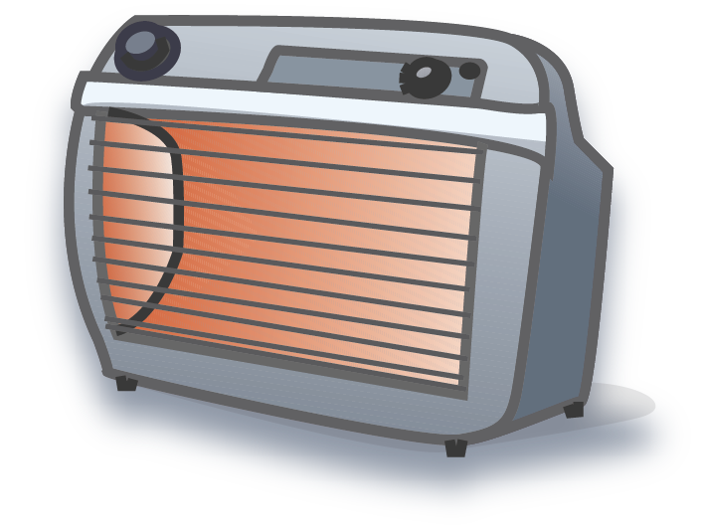
Heating Fire Prevention Tips
Keep anything that can burn at least three feet away from heating equipment - like the furnace, space heater, fireplace or wood stove.
Use products only for their intended purposes. Never use the oven to heat the home.
Have your heating system inspected by a qualified service professional at least once per year.
Install and maintain carbon monoxide (CO) alarms to avoid the risk of CO poisoning.
Place space heaters on level, flat surfaces, but never on furniture.
Keep space heaters out of high traffic areas and doorways.
Turn space heaters off when you leave the room or go to sleep.
Notes:
Colder winter weather increases the likelihood of heating related fires, fatalities, and injuries. Heating is the second leading cause of fire deaths for older adults. Many heating fires can be prevented by following a few easy safety tips.
A reproducible Home Heating Safety Tips handout and complementary full-color illustration are available in the ESFI Home Fire Safety for Older Adults Safety Awareness Program Toolkit.
Safety Tips:
http://esfi.org/index.cfm/page/Home-Heating-Safety-Tips-for-Older-Adults/cdid/12827/pid/11406
A comprehensive Home Fire Safety Checklist has also been developed to help older adults learn to identify and correct potential home fire hazards.
Checklist:
http://esfi.org/index.cfm/page/Home-Fire-Safety-Checklist-for-Older-Adults/cdid/12839/pid/11406
We encourage you to copy and distribute these resources as a component of your awareness efforts.
In addition, ESFI has created a new Home Heating Safety for Older Adults video public service announcement (PSA). This high-quality, 60-second safety video reinforces key heating fire prevention tips. The Home Heating Safety for Older Adults PSA and other safety videos developed specifically for the high-risk older adult population are available on ESFI’s website at www.esfi.org/educators.

Slide 9
Electrical Fire Prevention Tips
Routinely check cords, outlets, switches, and appliances for signs of damage.
Look and listen for warning signs of an electrical problem. Contact a licensed electrician if you observe:
Frequent problems with blowing fuses or tripping circuit breakers;
A tingling feeling or slight shock when you touch an appliance;
Outlets and switches that are warm or make crackling, sizzling or buzzing noises;
Flickering or dimming lights.
Do not overload outlets.
Use extension cords only temporarily.
Never run electrical cords under rugs or carpets.
Do not pinch cords under furniture or in windows/doors.
Always use light bulbs that match the wattage indicated on the lamp.
Notes:
Electricity has become such a standard part of our daily lives that it is often taken for granted, but electrical failures or malfunctions are a leading cause of home fires every year. Homes with aging electrical systems, in particular, are at increased risk for electrical fires. The risk of home electrical fires can be reduced by following these simple precautions.
A reproducible Home Electrical Safety Tips handout and complementary full-color illustration are available in the ESFI Home Fire Safety for Older Adults Safety Awareness Program Toolkit.
Safety Tips:
http://esfi.org/index.cfm/page/Home-Electrical-Safety-Tips-for-Older-Adults/cdid/12829/pid/11406
A comprehensive Home Fire Safety Checklist has also been developed to help older adults learn to identify and correct potential home fire hazards.
Checklist:
http://esfi.org/index.cfm/page/Home-Fire-Safety-Checklist-for-Older-Adults/cdid/12839/pid/11406
We encourage you to copy and distribute these resources as a component of your awareness efforts.
In addition, ESFI has created a new Home Electrical Safety for Older Adults video public service announcement (PSA). This high-quality, 60-second safety video reinforces key electrical fire prevention tips. The Home Electrical Safety for Older Adults PSA and other safety videos developed specifically for the high-risk older adult population are available on ESFI’s website at www.esfi.org/educators.

Slide 10
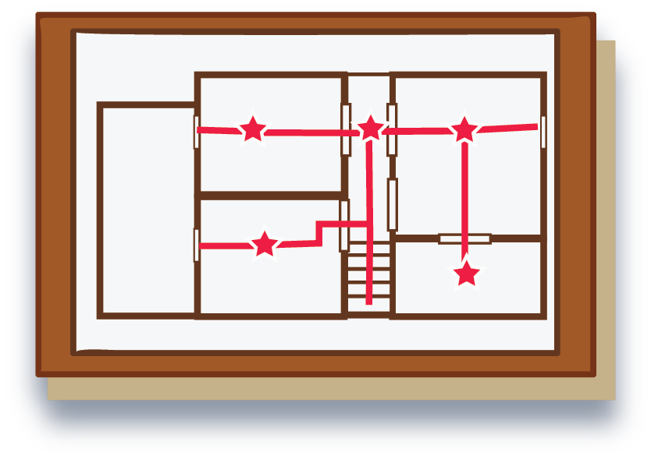
Fire Escape Planning Tips
Involve all family members in creating or updating the plan.
Walk through the home and note any possible exits including windows.
Draw a floor plan and mark two ways to escape from each room.
Consider using a ground floor bedroom to make escape easier.
Make sure all doors and windows can be opened easily.
Keep doorways, hallways, and stairs are clear of obstacles.
Use battery-powered lights to illuminate halls and exits or have flashlights ready.
If possible, assign a family member/caregiver to assist older adults or persons with mobility issues.
Practice the fire escape plan at least twice per year.
Update the fire escape plan as necessary to accommodate new health or mobility concerns.
Notes:
Once the smoke alarm sounds, there may be just a few minutes to get to safety. Everyone should have a family fire escape plan so that they are adequately prepared before a fire emergency happens. Additional planning may be needed to make sure older adults are adequately prepared to escape in the event of a fire emergency. Fire escape plans should be updated regularly to ensure they take into consideration the physical capabilities of older adults, including decreased mobility, poor vision or hearing, and other health issues. If possible, a loved ones and/or caregivers should be involved in the process of creating or updating the home fire escape plan.
A reproducible Fire Escape Planning handout and complementary full-color illustration are available in the ESFI Home Fire Safety for Older Adults Safety Awareness Program Toolkit. We encourage you to copy and distribute these resources as a component of your awareness efforts.
http://esfi.org/index.cfm/page/Fire-Escape-Planning-for-Older-Adults/cdid/12831/pid/11406
For more information about fire escape planning, visit ESFI’s website at http://www.esfi.org/index.cfm/page/Smoke-Alarms-and-Escape-Planning/pid/11281 and/or put your fire safety knowledge to the test with the Virtual Fire Drill http://virtualfiredrill.esfi.org.

Slide 11
Smoke Alarm Safety Tips
Smoke alarms should be installed in every bedroom, outside each sleeping area, and on every level of the home.
Purchase alarms that have the label of a nationally-recognized testing laboratory.
For the best protection, smoke alarms should be interconnected so that they all sound if one sounds.
Test smoke alarms every month by pressing the TEST button.
Replace batteries at least once a year or sooner if an alarm “chirps” or “beeps” to indicate low battery.
Occasionally dust or lightly vacuum the exterior of the alarm to remove dust and cobwebs.
Replace all smoke alarms at least every ten years.
Notes:
Smoke alarms save lives by providing early warning of fire, yet roughly two-thirds of home fire deaths occur in homes without working smoke alarms. The general smoke alarm safety tips on this slide will help ensure older adults are adequately protected by these critical safety devices.
The tips on the next slide provide additional information about smoke alarm technologies for those with hearing loss or who may not be awakened by the sound of a standard smoke alarm.
A reproducible Smoke Alarm Safety Tips handout and handy Smoke Alarm Maintenance Calendar are available in the ESFI Home Fire Safety for Older Adults Safety Awareness Program Toolkit. We encourage you to copy and distribute these resources as a component of your awareness efforts.
Safety Tips:
http://esfi.org/index.cfm/page/Smoke-Alarm-Safety-Tips-for-Older-Adults/cdid/12833/pid/11406
Maintenance Calendar:
http://esfi.org/index.cfm/page/Smoke-Alarm-Maintenance-Calendar/cdid/12837/pid/11406
Loved ones and/or caregivers are encouraged to assist older adults who may not be able to complete their smoke alarm maintenance activities without help.

Slide 12
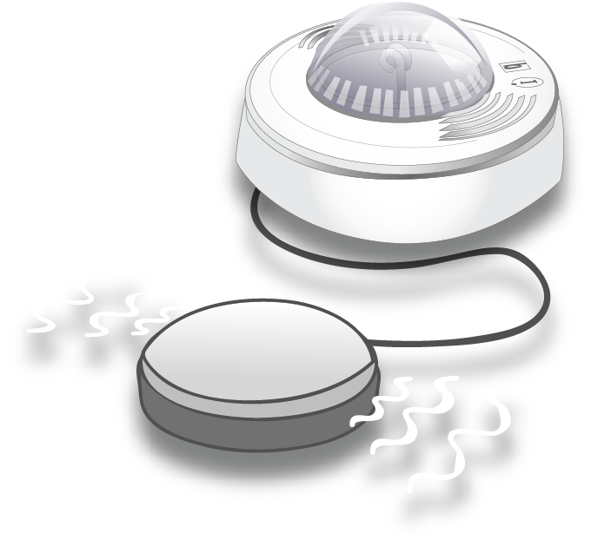
Smoke Alarm Safety Tips
Additional Considerations for Older Adults:
Test smoke alarms to make sure everyone can hear them - even when they are asleep. Some older adults may not be awakened by the sound of the smoke alarm.
Notification devices that produce complex low frequency audible signals can be used to awaken those with mild to severe hearing loss.
Consider installing smoke alarms that use flashing light or vibration if diminished hearing is a concern.
Smoke alarms with high intensity strobes can be used to wake the deaf or others who have profound hearing loss.
Pillow or bed shakers are required to be used with strobes.
Notes:
Age-related hearing loss or other physical disability may make it difficult for older adults to respond quickly to the sound of a standard smoke alarm. Additional smoke alarm safety warning devices should be considered in homes where older adults reside.
More information about these technologies is available on the reproducible Smoke Alarm Safety Tips handout and illustration in the ESFI Home Fire Safety for Older Adults Safety Awareness Program Toolkit. We encourage you to copy and distribute these resources as a component of your awareness efforts.
Smoke Alarm Safety Tips:
http://esfi.org/index.cfm/page/Smoke-Alarm-Safety-Tips-for-Older-Adults/cdid/12833/pid/11406

Slide 13
Additional Resources
Visit www.electrical-safety.org for access to all of ESFI’s free fire and electrical safety resources.
Electrical Safety Foundation International
(703) 841-3229
info@esfi.org

